Slide 1
Input New Location:
Latitude
Longitude
Date-time
Start here
Hour Changed?
NO
Append(Latitude, Longitude, Date-time) -> Current_Hour_Points
YES
Calculate Stay-points: in Current_Hour_Points
Add time between stay-points based on speed
Group stay-points to form states (Using DB to snap the stay-points)
States
Calculate Markov Chain Model on States
Calculate Hourly State Weights (time-slotted data)
Calculate transition matrix for the day passed.
NO
Date Changed?
YES

Slide 2
Hour t
4 5 6 7 8 9 10 11
Location Coordinates
Stay-points
SP₁ | SP₂ | …
States
st₁ | st₂ | …
Hour t
5 6 7 8 9 10 11
Time-slotted data
st₁, st₂ |  |  |  | st₂ | st₂
Markov Chain
… | …
MC₄ | MC₅ | MC₆ | MC₇ | MC₈ | MC₉ | MC₁₀ | MC₁₁ | MC₁₂ | MC₁₃
… | …

Slide 3
p4
p1
p3
st₁
st₂
p2
p4
p1
p3
st₁
st₂
p2
p5
p6
st₃
p4
p7
p8

Slide 5
GPS Trajectory Points
Markov Model
Stay-points Detection
Next Location Prediction
State Transitions
State Formation
Time-slotted States

Slide 6



Slide 7

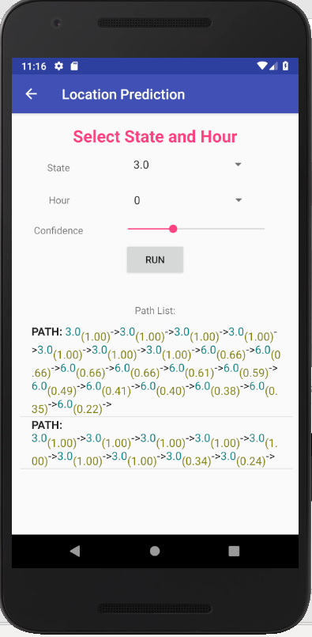

Slide 8
Hour t
4 5 6 7 8 9 10 11
st₁
st₂
st₃
Hour t
4 5 6 7 8 9 10 11
st₁
st₂
st₃
st₁ = 10/60
st₂ = 35/60
st₁ = 60/60

Slide 9
0.78
0.22
0
st₁
st₂
0
Hour t
4 5 6 7 8 9 10 11
st₁
st₂
st₃
st₁ = 0.22
st₂ = 0.78
st₁ = 1

Slide 10
Snapping same stay-points to form states
Hour t
4 5 6 7 8 9 10 11
STAYPOINTS
SP1
SP2
SP3
SP4
STAYPOINTS
Hour t
4 5 6 7 8 9 10 11
STATES
ST1
ST2
ST1
ST2
STATES
Hour t
4 5 6 7 8 9 10 11
STATE WEIGHTS
W_{ST1}=
0.6667
W_{ST2}=
0.6667
W_{ST2}=
0.9167
W_{ST1}=
0.6667
W_{ST1}=
0.4167
W_{ST2}=
0.4167
W_{ST2}=1
W_{ST2}=0.333
STATE WEIGHTS

Slide 11
Location Coordinates
Snapping same stay-points to form states
Hour t
4 5 6 7 8 9 10 11
STAYPOINTS
STAYPOINTS
Stay-points
Hour t
4 5 6 7 8 9 10 11
STATES
st₁
st₁
STATES
States

Slide 12
State hourly weight
Hour t
4 5 6 7 8 9 10 11
STATE WEIGHTS
W₁=
0.67
W₁=
0.92
W₁=0.42
W₁=0.33
STATE WEIGHTS
Hour t
4 5 6 7 8 9 10 11
N-STATE WEIGHTS
W₁=1
W₁=1
W₁=1
W₁=1
N-STATE WEIGHTS
Normalized State hourly weight

Slide 13
State Hourly Weights
…
W_{ST1(4)} = (04:45 - 04:05).minutes/60 = 40/60 = 0.6667
W_{ST2(4)} = 0
W_{ST1(5)} = 0
W_{ST2(5)} = (06:00 - 05:20).minutes/60 = 40/60 = 0.6667
W_{ST1(6)} = 0
W_{ST2(6)} = (06:55 – 06:00).minutes/60 = 55/60 = 0.9167
W_{ST1(7)} = (08:00 – 07:20).minutes/60 = 40/60 = 0.6667
W_{ST2(7)} = 0
W_{ST1(8)} = (08:25 – 08:00).minutes/60 = 25/60 = 0.4167
W_{ST2(8)} = (09:00 – 08:35).minutes/60 = 25/60 = 0.4167
W_{ST1(9)} = 0
W_{ST2(9)} = (10:00 – 09:00).minutes/60 = 60/60 = 1
W_{ST1(10)} = 0
W_{ST2(10)} = (10:20 - 10:00).minutes/60 = 20/60 = 0.3333
…

Slide 14
Hourly Matrix
STATES-> ST1 ST2
t₄ = [ 0.6667 0 ]
t₅ = [ 0 0.6667 ]
t₆ = [ 0 0.9167 ]
t₇ = [ 0.6667 0 ]
t₈ = [ 0.4167 0.4167 ]
t₉ = [ 0 1 ]
t₁₀ = [ 0 0.3333 ]
ST1
ST2
ST1 | ST2
0.6667
0
t₄₋₅=
0 | 0.6667
ST1 | ST2
ST1
ST2
0 | 0.4445
0 | 0
t₄₋₅=
Markov Chain t₄₋₅
0.4445
0
0
ST1
ST2
0

Slide 15


Slide 16
th_d
state st_{i}
new stay-point sp_{j}
state st_{i} new mean
state st_{i} current mean

Slide 17
th_d
th_d
stay-point “home”
stay-point “home” mean
new stay-point “work”
stay-point “work’ mean
travelling from “home” to “work”

Slide 18
st = {st₁, st₂, …st_{n}}
sp = {sp_{1,} sp₂, … sp_{n}}
w = {w₁, w_{2, …} w_{k}}

